Slide 1
Жесточайшая
Оптимизация скорости
загрузки веб-страниц
Дима Дудин @nedudi

Slide 2



Slide 3

Зачем ?
… неужели это так важно

Slide 4
1
секунда?
Notes:
1-секундная задержка в загрузке веб-страницы влечет за собой:
11% - потеря количества просмотров.
16% - потеря удовлетворенности клиентов
7% - потеря конверсии

Slide 5

Notes:
Иногда мы не знаем, что будет через 1 сек

Slide 6

Notes:
Иногда 1 сек все тотально решает

Slide 7

Notes:
According to the Guinness Book of World Records, Steven Petrosino is the Beer Chugging World Champion. On June 22, 1977, he drank 1 liter of beer in 1.3 seconds at the Gingerbreadman in Carlise, PA, a 56% improvement over the previous world record set several years earlier by Peter Dowdeswell of England (2.3 seconds for 1 liter)

Slide 8
1 секунда в WEB
11% - потеря количества просмотров.
16% - потеря удовлетворенности клиентов
7% - потеря конверсии
Notes:
1-секундная задержка в загрузке веб-страницы влечет за собой:
11% - потеря количества просмотров.
16% - потеря удовлетворенности клиентов
7% - потеря конверсии

Slide 9
Конверсия магазинов увеличивается на
74%
при уменьшении
времени загрузки
с 8 до 2 секунд
Notes:
1-секундная задержка в загрузке веб-страницы влечет за собой:
11% - потеря количества просмотров.
16% - потеря удовлетворенности клиентов
7% - потеря конверсии

Slide 10
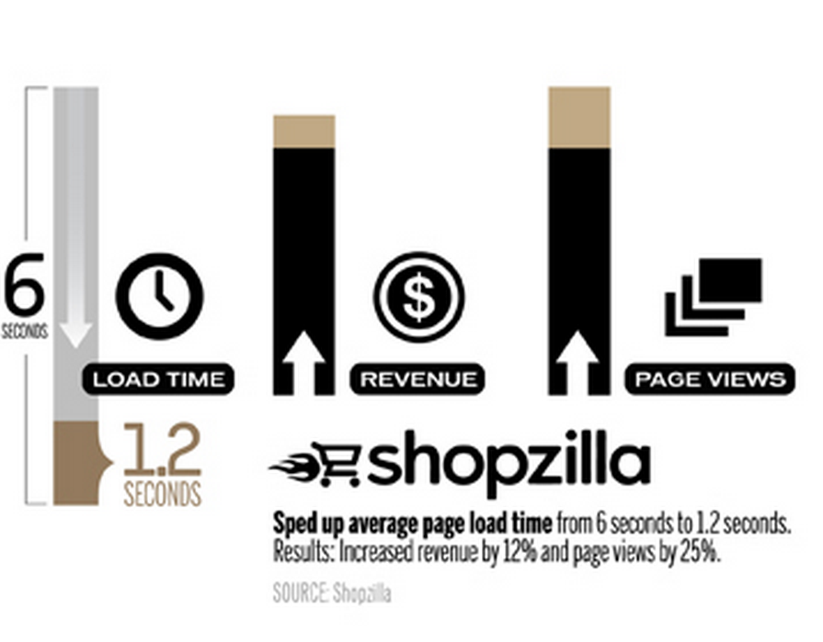
Notes:
Shopzilla ускорить среднее время загрузки страницы из 6 секунд до 1,2 секунд, а увеличение доходов на 12% и просмотров страниц на 25%.
Amazon увеличил выручку на 1% за каждые 100 мс улучшения (так же, как Walmart).
Yahoo увеличение трафика на 9% за каждые 400 мс улучшения.
Наконец, Mozilla получили 60 миллионов больше Firefox загрузок в год, делая свои страницы 2,2 секунды быстрее.

Slide 11


Slide 12
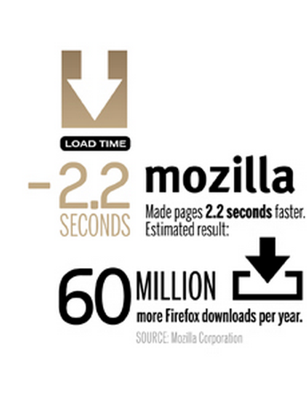

Slide 13


Slide 14

Деньги - не главное

Slide 15

Notes:
мы все ждем такой реакции пользователя

Slide 16

Notes:
а что мы зачастую получаем

Slide 17
Как понять ?
… анализы, анализы

Slide 18
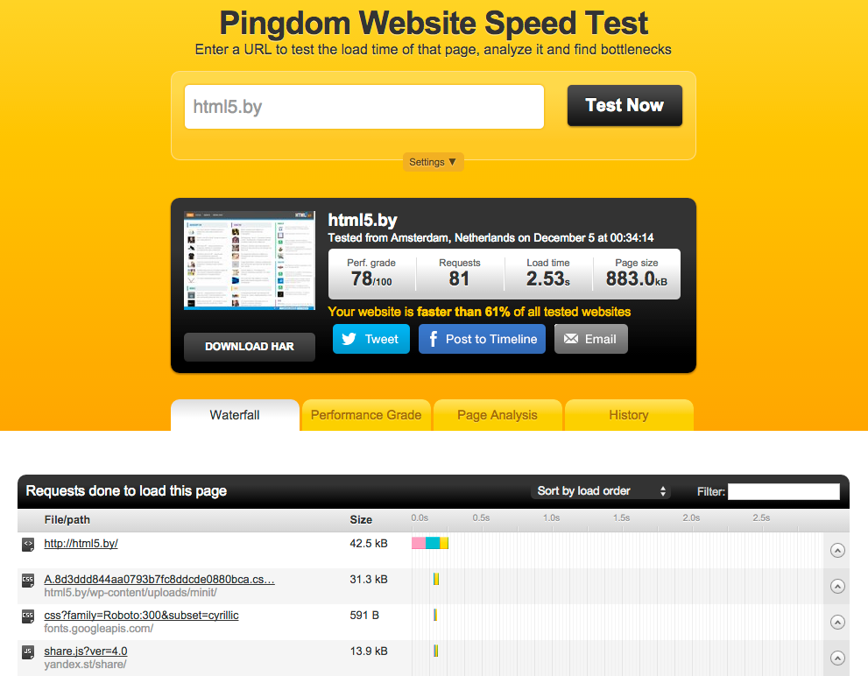
Pingdom

Slide 19
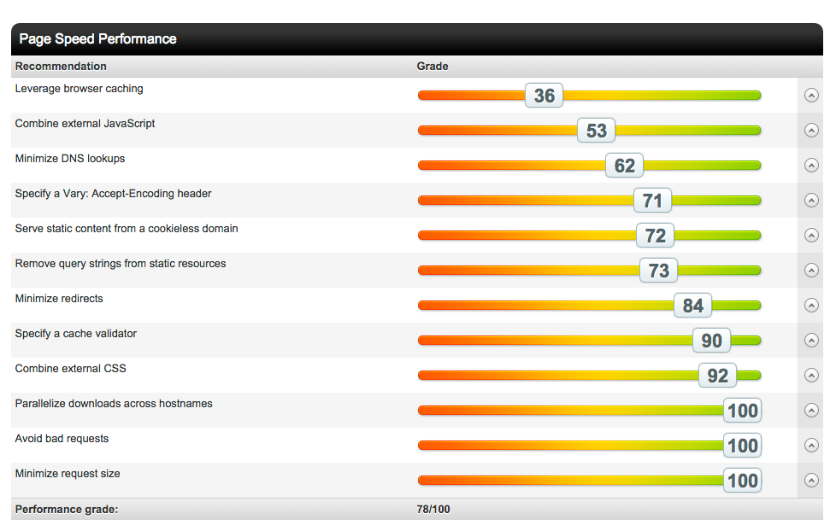
Pingdom

Slide 20
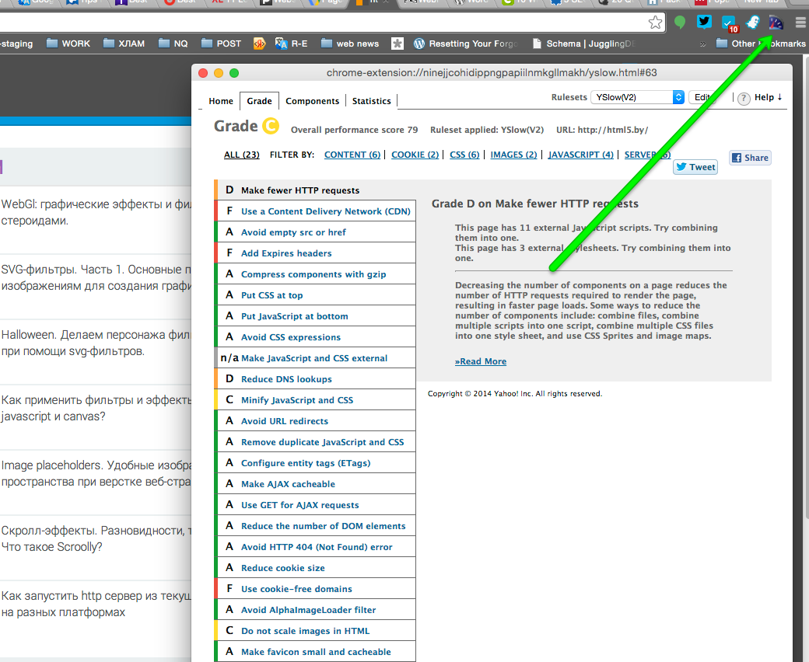
YSLOW

Slide 21

WEBPAGETEST

Slide 22
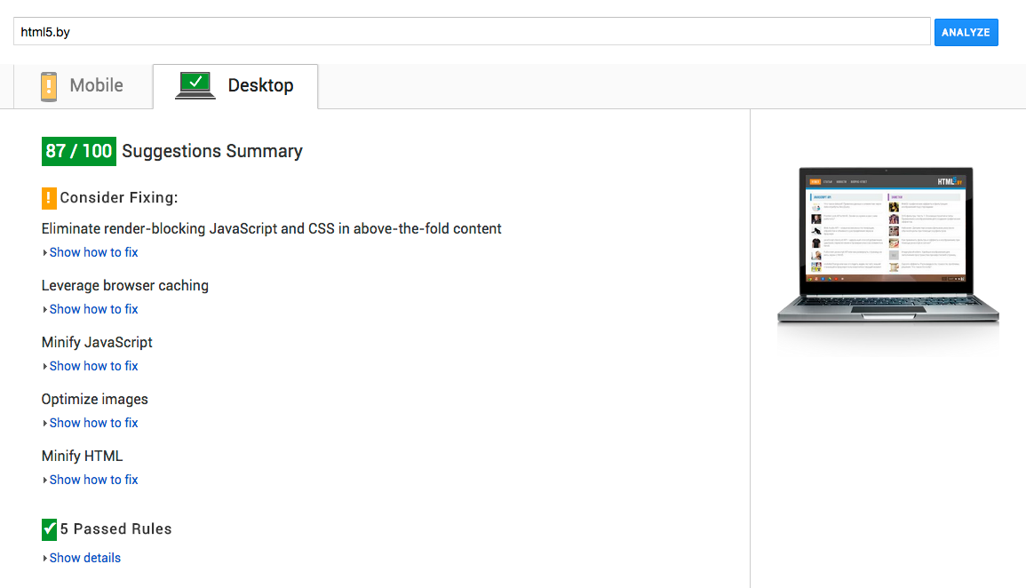
pagespeed

Slide 23
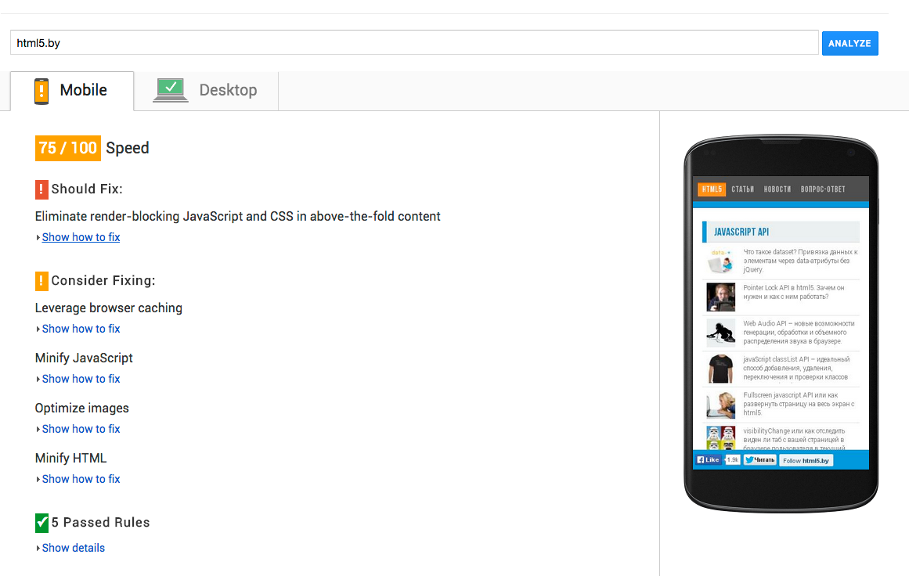
pagespeed

Slide 24
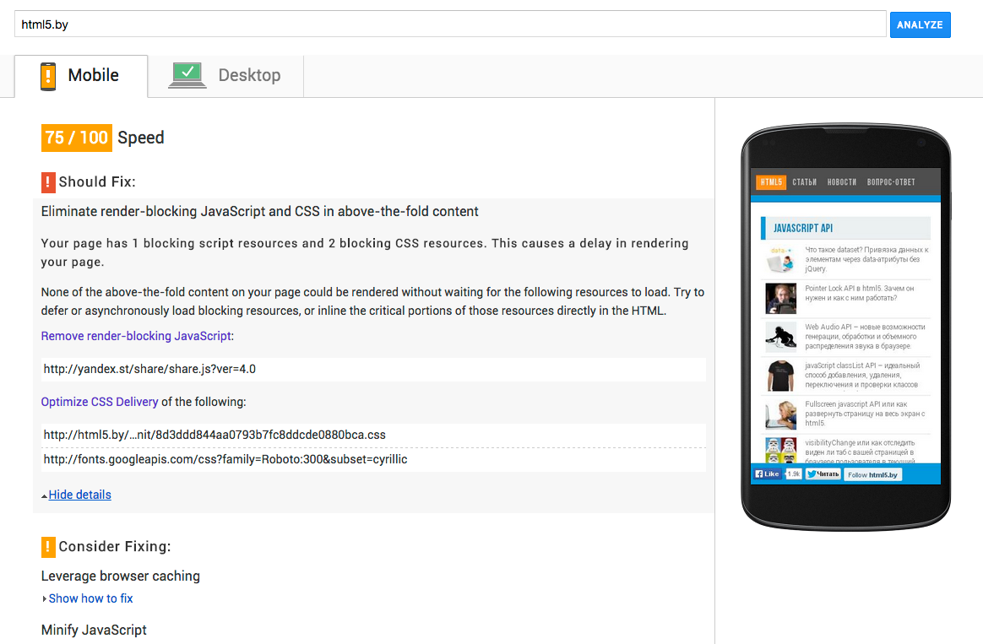
pagespeed

Slide 25
Типовые проблемы
… тяжко жить веб-разработчику
Notes:
информационно-развлекательных систем

Slide 26
РАЗМЕР ИЗОБРАЖЕНИЙ
Notes:
http://addyosmani.com/blog/image-optimization-tools/
As we saw a few weeks ago, the weight of an average web page is now almost 1.5MB (median ~1MB), with > 50% of this being images
указывайте аттрибуты
юзайте спратйы

Slide 27
авто
Сжималки
разрезалки
спрайты и тп…

Slide 28
grunt-contrib-imagemin
grunt-imageoptim
grunt-webp
grunt-imageNormalize
grunt-image-resize
grunt-spritefiles
grunt-montage
…….
addyosmani.com/blog/image-optimization-tools

Slide 29
<Picture>

Slide 30


Slide 31


Slide 32
<picture>
<source
media="(min-width: 650px)"
srcset="images/kitten-stretching.png">
<source
media="(min-width: 465px)"
srcset="images/kitten-sitting.png">
<img
src="images/kitten-curled.png"
alt="a cute kitten">
</picture>
vimeo.com/108326836

Slide 33
И еще …
<img src=“hi.png"
height="100" width=“100”
/>

Slide 34
ФОРМАТЫ ИЗОБРАЖЕНИЙ

Slide 35
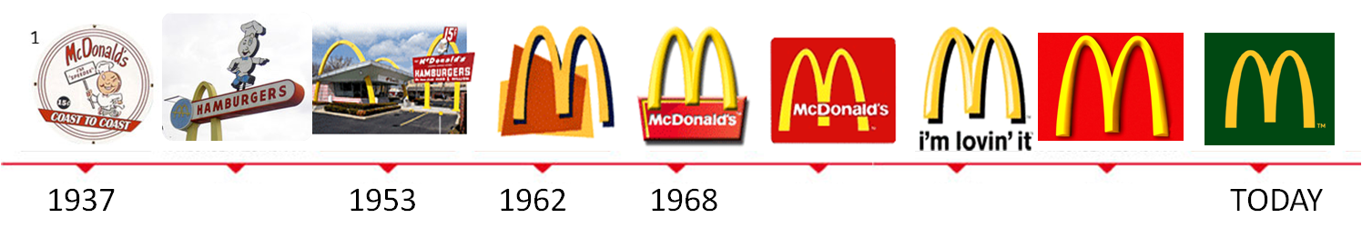

Slide 36

JPEG

Slide 37

PNG

Slide 38

SVG

Slide 39
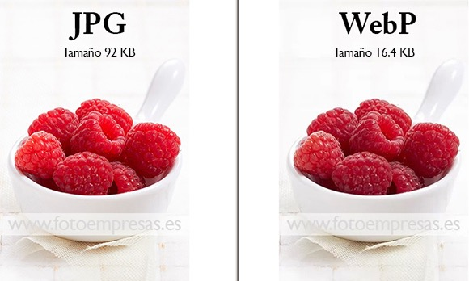

Slide 40
Lazy
loading…

Slide 41


Slide 42
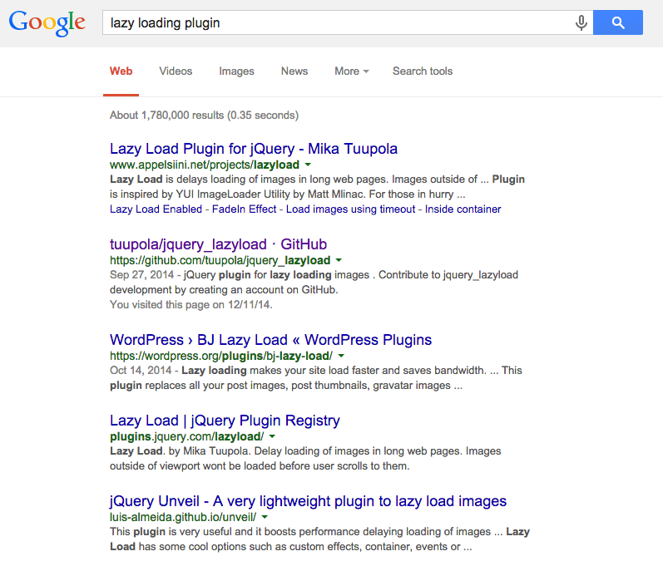

Slide 43
GZIP
Notes:
. Why GZIP?
• GZIP is not the best compression method, but there are a few good reasons to use it.
• Provides a good tradeoff between speed and ratio.
• Difﬁculty to add newer compression methods.
The "Content-Encoding"/"Accept-Encoding" and "Transfer-Encoding"/"TE" headers in HTTP/1.1 allow clients to optionally receive compressed HTTP responses and (less commonly) to send compressed requests. The specification for HTTP/1.1 (RFC 2616) specifies three compression methods: "gzip" (RFC 1952; the content wrapped in a gzip stream), "deflate" (RFC 1950; the content wrapped in a zlib-formatted stream), and "compress" (explained in RFC 2616 section 3.5 as "The encoding format produced by the common UNIX file compression program compress. This format is an adaptive Lempel-Ziv-Welch coding (LZW)."). Many client libraries, browsers, and server platforms (including Apache and Microsoft IIS) support gzip. Many agents also support deflate, although several important players incorrectly implement deflate support using the format specified by RFC 1951 instead of the correct format specified by RFC 1950 (which encapsulates RFC 1951). Notably, Internet Explorer versions 6, 7, and 8 report deflate support but do not actually accept RFC 1950 format, making actual use of deflate highly unusual. Many clients accept both RFC 1951 and RFC 1950-formatted data for the "deflate" compressed method, but a server has no way to detect whether a client will correctly handle RFC 1950 format.[9]

Slide 44
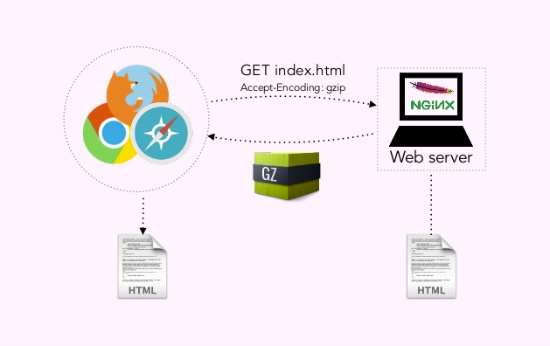
Notes:
Accept-Encoding: gzip

Slide 45
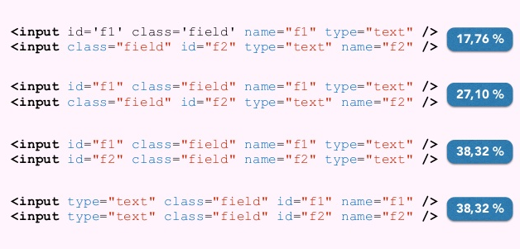
Notes:
What is GZIP? Web server GET index.html Accept-Encoding: gzip

Slide 46
Cache
Notes:
Add an Expires header

Slide 47
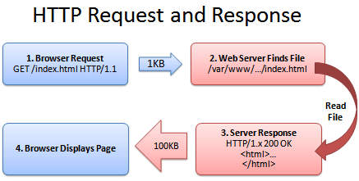
CACHE отключен
Notes:
http://betterexplained.com/articles/how-to-optimize-your-site-with-http-caching/
http://www.mobify.com/blog/beginners-guide-to-http-cache-headers/

Slide 48
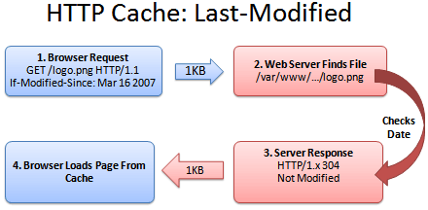
1. Last-Modified
Last-modified: Fri, 16 Mar 2007 04:00:25 GMT File Contents (could be an image, HTML, CSS, Javascript...)
Notes:
Browser: Hey, give me logo.png, but only if it’s been modified since Mar 16, 2007.
Server: (Checking the modification date)
Server: Hey, you’re in luck! It was not modified since that date. You have the latest version.
Browser: Great! I’ll show the user the cached version.
Sending the short “Not Modified” message is a lot faster than needing to download the file again, especially for giant javascript or image files. Caching saves the day (err… the bandwidth).

Slide 49
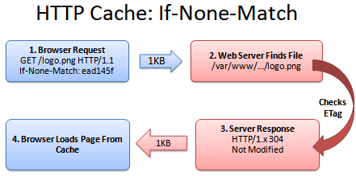
2. ETag
ETag: ead145f File Contents (could be an image, HTML, CSS, Javascript...)
Notes:
Сравнивая версии с временем изменения обычно работает, но может привести к проблемам. Что делать, если часы сервера изначально неправильно, а затем устроился? Что делать, если летнее время наступает рано и сервер не обновляется? В тайниках может быть неточным.
Browser: Can I get logo.png, if nothing matches tag “ead145f”?
Server: (Checking fingerprint on logo.png)
Server: You’re in luck! The version here is “ead145f”. It was not modified.
Browser: Score! I’ll show the user my cached version.

Slide 50
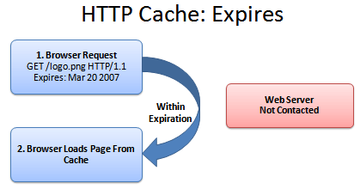
3. EXPIRES
Expires: Tue, 20 Mar 2007 04:00:25 GMT File Contents (could be an image, HTML, CSS, Javascript...)
Notes:
Browser: Self, is it before the expiration date of Mar 20, 2007? (Assume it is).
Browser: Verily, I will show the user the cached version.

Slide 51

<IfModule mod_expires.c>
ExpiresActive On
ExpiresByType image/jpg "access plus 1 year"
ExpiresByType image/jpeg "access plus 1 year"
ExpiresByType image/gif "access plus 1 year"
ExpiresByType image/png "access plus 1 year"
ExpiresByType text/css "access plus 1 month"
ExpiresByType application/pdf "access plus 1 month"
ExpiresByType text/x-javascript "access plus 1 month"
ExpiresByType image/x-icon "access plus 1 year"
ExpiresDefault "access plus 2 days"
</IfModule>

Slide 52

server {
...
location ~* \.(gif|ico|jpe?g|png)(\?[0-9]+)?$ {
expires 1w;
}
location ~* \.(css|js)$ {
expires 1d;
}
...
}

Slide 53
4. MAX AGE
cache-control: max-age=0
1 day in seconds = 86400
1 week in seconds = 604800
1 month in seconds = 2629000
1 year in seconds = 31536000
(effectively infinite on internet time)

Slide 54
5. Public and Private
cache-control: private
Cache-control: public
Cache-control: private
Cache-control: no-cache

Slide 55
<ifModule mod_headers.c>
<FilesMatch "\.(gif|ico)$">
Header set Cache-Control "max-age=2592000, public"
</FilesMatch>
<FilesMatch "\.(js)$">
Header set Cache-Control "max-age=86400,
private, must-revalidate"
</FilesMatch>
<FilesMatch "\.(php)$">
Header set Cache-Control "private, no-store, no-cache,
must-revalidate, no-transform, max-age=0"
Header set Pragma "no-cache"
</FilesMatch>
</ifModule>

Slide 56
server {
...
location ~* \.(?:ico|css|js|gif|jpe?g|png)$ {
add_header Cache-Control "max-age=86400, public";
}
...
}

Slide 57
обфускация
js сss html

Slide 58
Сборка
js сss

Slide 59
JavaScript
в конец документа

Slide 60
CSS
в начало документа
?
Notes:
Avoid CSS @import

Slide 61
CDN

Slide 62
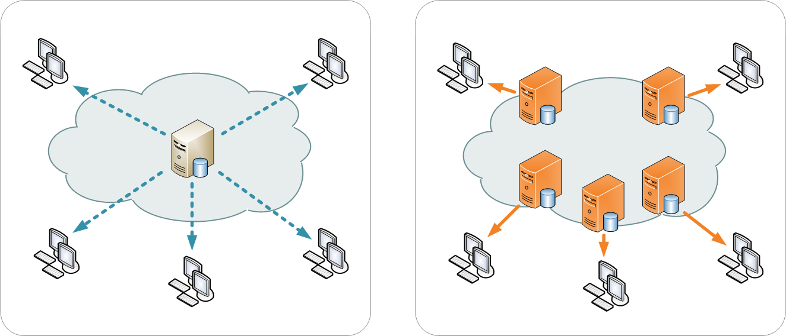
Notes:
Но на самом деле все не так просто.
У Tizen есть длинная предистория.
Выглядит она приблизительно так:

Slide 63
Notes:
Но на самом деле все не так просто.
У Tizen есть длинная предистория.
Выглядит она приблизительно так:

Slide 64


Notes:
Но на самом деле все не так просто.
У Tizen есть длинная предистория.
Выглядит она приблизительно так:

Slide 65
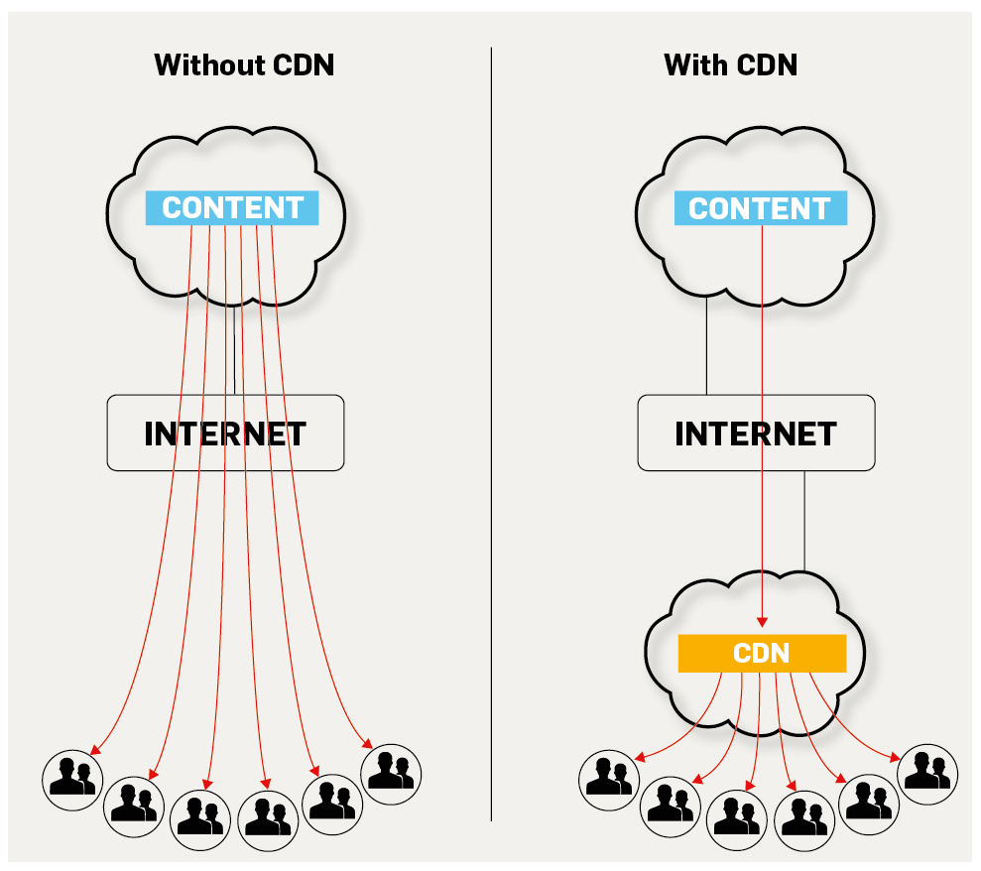
Notes:
Но на самом деле все не так просто.
У Tizen есть длинная предистория.
Выглядит она приблизительно так:

Slide 66
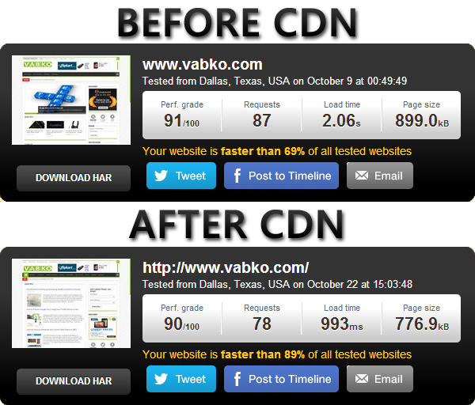
Notes:
Но на самом деле все не так просто.
У Tizen есть длинная предистория.
Выглядит она приблизительно так:

Slide 67
DNS
Lookup time
Notes:
Reduce DNS Lookups:
DNS (Domain Name System) Lookup occurs when a URL (hostname) is typed in a browser and a DNS resolver returns that server’s IP address. The time needed for this process is around 20 – 120 milliseconds, however, multiple hostnames can be used for various elements on a website, which includes the URL, images, script files, style sheets and flash elements. With multiple unique hostnames the DNS lookup also increases thus increasing the page load time. Reducing the number of unique hostnames will reduce the number of parallel downloads, which may increase the page loading time. It is thus ideal to use one host when you have less than six resources. You can also use URL paths instead of hostnames. This means that if you have a blog page that is hosted on blog.yoursite.com, you can instead host it on www.yoursite.com/blog.

Slide 68
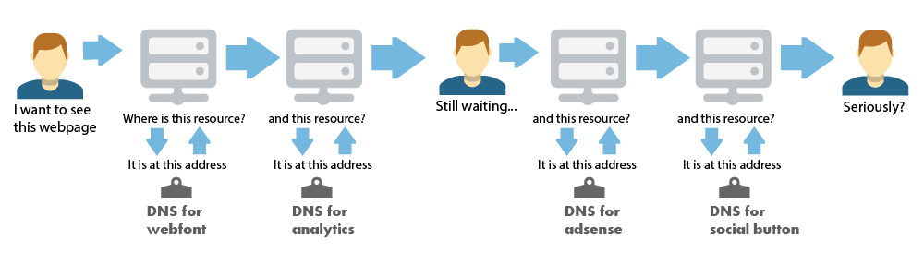
Notes:
Know what your webpage is doing. Decide what is important to your page.

Slide 69
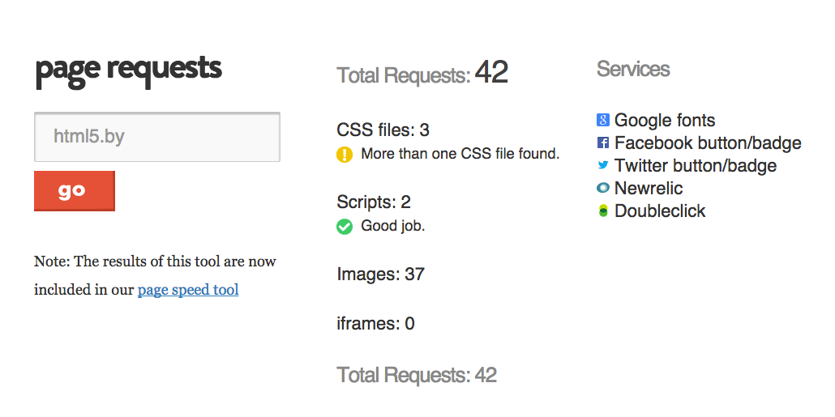
feedthebot.com/tools/requests
Notes:
Know what your webpage is doing. Decide what is important to your page.

Slide 70
<link rel="dns-prefetch" href="//trololo.com">
Notes:
Know what your webpage is doing. Decide what is important to your page.

Slide 71
Enable
Keep-AlivE
Notes:
Reduce DNS Lookups:
DNS (Domain Name System) Lookup occurs when a URL (hostname) is typed in a browser and a DNS resolver returns that server’s IP address. The time needed for this process is around 20 – 120 milliseconds, however, multiple hostnames can be used for various elements on a website, which includes the URL, images, script files, style sheets and flash elements. With multiple unique hostnames the DNS lookup also increases thus increasing the page load time. Reducing the number of unique hostnames will reduce the number of parallel downloads, which may increase the page loading time. It is thus ideal to use one host when you have less than six resources. You can also use URL paths instead of hostnames. This means that if you have a blog page that is hosted on blog.yoursite.com, you can instead host it on www.yoursite.com/blog.

Slide 72
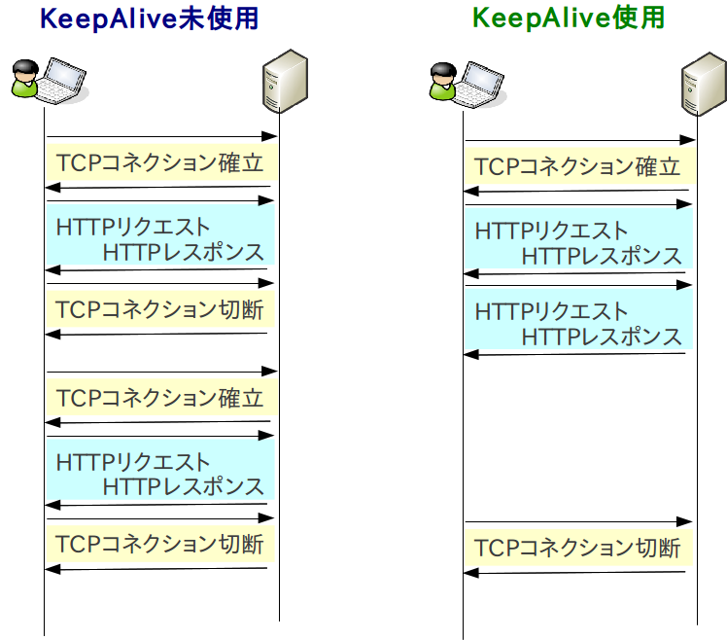

Notes:
Know what your webpage is doing. Decide what is important to your page.

Slide 73
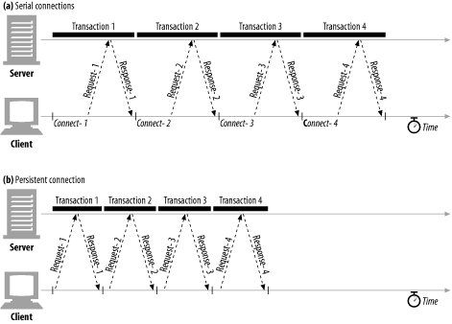
Notes:
Know what your webpage is doing. Decide what is important to your page.

Slide 74
избегаем
javascript
редиректов

Slide 75
Google Pagespeed
… xoчу все сразу
Notes:
информационно-развлекательных систем

Slide 76

хочу
все
и
сразу
Notes:
MaxCombinedCssBytes
MaxSegmentLength

Slide 77
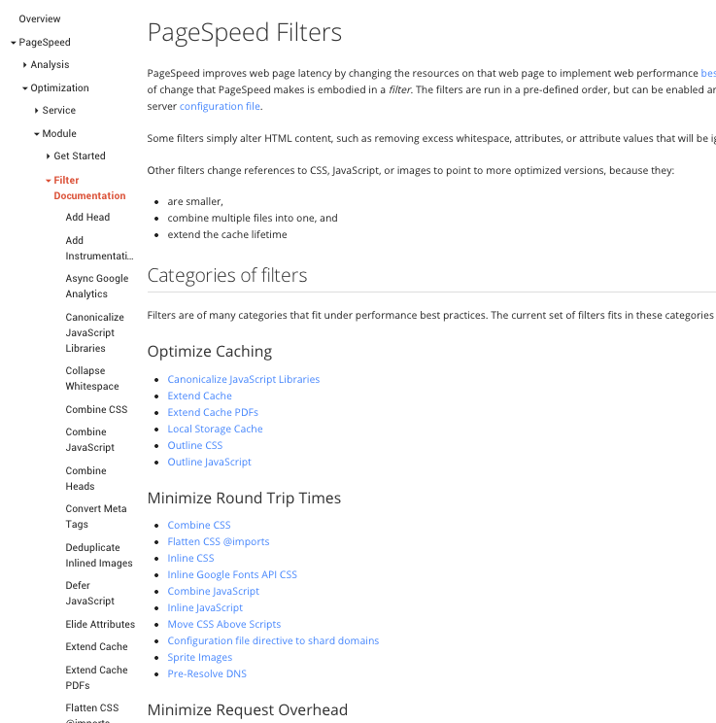
developers.google.com/speed/pagespeed/module/filters
Notes:
MaxCombinedCssBytes
MaxSegmentLength

Slide 78


pagespeed
Notes:
MaxCombinedCssBytes
MaxSegmentLength

Slide 79
Collapse Whitespace
Apache
ModPagespeedEnableFilters collapse_whitespace
Nginx
pagespeed EnableFilters collapse_whitespace;

Slide 80
Pre-Resolve DNS
Apache
ModPagespeedEnableFilters insert_dns_prefetch
Nginx
pagespeed EnableFilters insert_dns_prefetch;

Slide 81
combine css
Apache
ModPagespeedEnableFilters combine_css
Nginx
pagespeed EnableFilters combine_css;
Notes:
MaxCombinedCssBytes
MaxSegmentLength

Slide 82
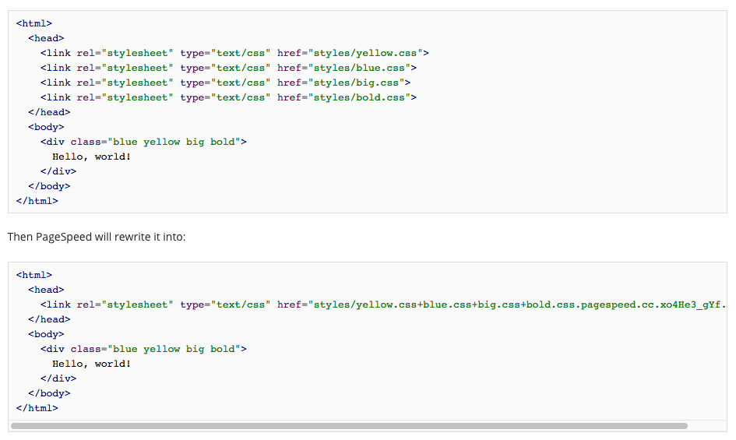
Notes:
MaxCombinedCssBytes
MaxSegmentLength

Slide 83
Minify CSS
Apache
ModPagespeedEnableFilters rewrite_css
Nginx
pagespeed EnableFilters rewrite_css;
Notes:
MaxCombinedCssBytes
MaxSegmentLength

Slide 84
Move CSS to Head
Apache
ModPagespeedEnableFilters move_css_to_head
Nginx
pagespeed EnableFilters move_css_to_head;
Notes:
MaxCombinedCssBytes
MaxSegmentLength

Slide 85
Prioritize Critical CSS
Apache
ModPagespeedEnableFilters prioritize_critical_css
Nginx
pagespeed EnableFilters prioritize_critical_css;
Notes:
MaxCombinedCssBytes
MaxSegmentLength

Slide 86
combine js
Apache
ModPagespeedEnableFilters combine_javascript
Nginx
pagespeed EnableFilters combine_javascript;
Notes:
MaxCombinedCssBytes
MaxSegmentLength

Slide 87
Minify Js
Apache
ModPagespeedEnableFilters rewrite_javascript
Nginx
pagespeed EnableFilters rewrite_javascript;
Notes:
MaxCombinedCssBytes
MaxSegmentLength

Slide 88
Canonicalize JavaScript Libraries
Apache
ModPagespeedEnableFilters canonicalize_javascript_libraries
Nginx
pagespeed EnableFilters
canonicalize_javascript_libraries;
Notes:
defer_javascript tries to defer JavaScript execution until page load. It defers this by changing the type and src attributes of <script> elements on the HTML page to pagespeed_orig_type and pagespeed_orig_src respectively. It also adds a new type attribute whose value is set to text/psajs. A window.onload handler is added to the HTML, which executes all the deferred scripts.
defer_javascript doesn't defer a script tag if it has the pagespeed_no_defer attribute. This is useful when a script tag needs to be executed while loading the page. For example, a script tag may be updating the main content dynamically as a slideshow of images in the visible content of the page. Usage:

Slide 89
Include JavaScript Source Maps
Apache
ModPagespeedEnableFilters
include_js_source_maps
Nginx
pagespeed EnableFilters
include_js_source_maps;
Notes:
defer_javascript tries to defer JavaScript execution until page load. It defers this by changing the type and src attributes of <script> elements on the HTML page to pagespeed_orig_type and pagespeed_orig_src respectively. It also adds a new type attribute whose value is set to text/psajs. A window.onload handler is added to the HTML, which executes all the deferred scripts.
defer_javascript doesn't defer a script tag if it has the pagespeed_no_defer attribute. This is useful when a script tag needs to be executed while loading the page. For example, a script tag may be updating the main content dynamically as a slideshow of images in the visible content of the page. Usage:

Slide 90
Move CSS Above Scripts
Apache
ModPagespeedEnableFilters
move_css_above_scripts
Nginx
pagespeed EnableFilters
move_css_above_scripts;
Notes:
defer_javascript tries to defer JavaScript execution until page load. It defers this by changing the type and src attributes of <script> elements on the HTML page to pagespeed_orig_type and pagespeed_orig_src respectively. It also adds a new type attribute whose value is set to text/psajs. A window.onload handler is added to the HTML, which executes all the deferred scripts.
defer_javascript doesn't defer a script tag if it has the pagespeed_no_defer attribute. This is useful when a script tag needs to be executed while loading the page. For example, a script tag may be updating the main content dynamically as a slideshow of images in the visible content of the page. Usage:

Slide 91
Defer JavaScript
Apache
ModPagespeedEnableFilters defer_javascript
Nginx
pagespeed EnableFilters defer_javascript;
Notes:
defer_javascript tries to defer JavaScript execution until page load. It defers this by changing the type and src attributes of <script> elements on the HTML page to pagespeed_orig_type and pagespeed_orig_src respectively. It also adds a new type attribute whose value is set to text/psajs. A window.onload handler is added to the HTML, which executes all the deferred scripts.
defer_javascript doesn't defer a script tag if it has the pagespeed_no_defer attribute. This is useful when a script tag needs to be executed while loading the page. For example, a script tag may be updating the main content dynamically as a slideshow of images in the visible content of the page. Usage:

Slide 92
Deduplicate Inlined Images
Apache
ModPagespeedEnableFilters dedup_inlined_images
Nginx
pagespeed EnableFilters dedup_inlined_images;
Notes:
Description
dedup_inlined_images replaces repeated inlined images with JavaScript that loads the image from the first occurence of the image. If the first image doesn't have an id, one is generated and added to it.
Operation
dedup_inlined_images rewrites inlined images:
If the image's data URL has not appeared earlier in the page then, if it doesn't already have one an id attribute is generated and added to the tag, then the existing/added id is recorded along with the data URL for comparison with subsequent inlined images.
Otherwise, the <img> tag is replaced with an inline <script> tag that replaces itself with an <img> tag, loading the data URL from the preceding <img> tag with the id matching this tag's data URL.

Slide 93
Elide Attributes
Apache
ModPagespeedEnableFilters elide_attributes
Nginx
pagespeed EnableFilters elide_attributes;
Notes:
defer_javascript tries to defer JavaScript execution until page load. It defers this by changing the type and src attributes of <script> elements on the HTML page to pagespeed_orig_type and pagespeed_orig_src respectively. It also adds a new type attribute whose value is set to text/psajs. A window.onload handler is added to the HTML, which executes all the deferred scripts.
defer_javascript doesn't defer a script tag if it has the pagespeed_no_defer attribute. This is useful when a script tag needs to be executed while loading the page. For example, a script tag may be updating the main content dynamically as a slideshow of images in the visible content of the page. Usage:

Slide 94
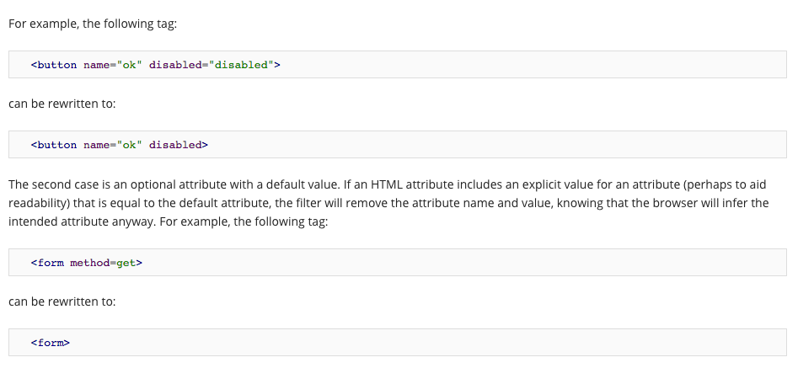
Notes:
MaxCombinedCssBytes
MaxSegmentLength

Slide 95
Extend Cache
Apache
ModPagespeedEnableFilters extend_cache
Nginx
pagespeed EnableFilters extend_cache;
Notes:
'Extend Cache' seeks to improve the cacheability of a web page's resources without compromising the ability of site owners to change the resources and have those changes propagate to users' browsers.
This filter is based on the best practice to optimize caching, as applied to the browser.

Slide 96
Flatten CSS Imports
Apache
ModPagespeedEnableFilters flatten_css_imports
Nginx
pagespeed EnableFilters flatten_css_imports;
Notes:
Reduce the number of HTTP round-trips by combining multiple CSS resources into one.

Slide 97
Lazyload Images
Apache
ModPagespeedEnableFilters lazyload_images
Nginx
pagespeed EnableFilters lazyload_images;
Notes:
Reduce the number of HTTP round-trips by combining multiple CSS resources into one.

Slide 98
Sprite Images
Apache
ModPagespeedEnableFilters sprite_images
Nginx
pagespeed EnableFilters sprite_images;
Notes:
Reduce the number of HTTP round-trips by combining multiple CSS resources into one.

Slide 99
Optimize Images
inline_images +
recompress_images +
convert_png_to_jpeg +
resize_images
Apache
ModPagespeedEnableFilters rewrite_images
Nginx
pagespeed EnableFilters rewrite_images;
Notes:
Reduce the number of HTTP round-trips by combining multiple CSS resources into one.

Slide 100
Local Storage Cache
Apache
ModPagespeedEnableFilters local_storage_cache
Nginx
pagespeed EnableFilters local_storage_cache;
Notes:
Reduce the number of HTTP round-trips by combining multiple CSS resources into one.

Slide 101

ЭКСПЕРИМЕНТИРУЙТЕ
Notes:
информационно-развлекательных систем

Slide 102

НИКОМУ НЕ ВЕРЬТЕ
Notes:
MaxCombinedCssBytes
MaxSegmentLength

Slide 103





Вопросы ?
nedudi@gmail.com
html5.by
twitter.com/html5by
facebook.com/html5by
vk.com/html5by

